Slide 1
Division 7A
17 May 2023

Slide 2
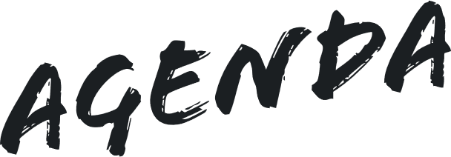

Introduction – Alex
Status of Reforms – Jordan
Technical Matters – Alex & Stef

Slide 3
What is Div. 7A?
Division 7A is part of the Income Tax Assessment Act 1936 and is an anti-avoidance measure intended to prevent profits or assets being provided to shareholders or their associates tax free.
It is one of the most complex and challenging areas of Australian tax legislation. With the promise of reform being constantly deferred, tax practitioners continue to be faced with provisions that are difficult to navigate.
It can apply to amounts paid, lent, forgiven, or the provision of assets for use made by a private company to a shareholder or associates.

Slide 4
Status of Reforms: Complying Loan Terms
Current law – s 109N
Unsecured loan
7 year annual principal + interest (benchmark rate).
Secured loan
25 year annual principal + interest (benchmark rate).
Board of Taxation (BOT) Report 2014
Unsecured Rule 78 loan
Business income election
Unsecured at call interest only (RBA Rate)
No progressive repayments of principal
Reborrowing permitted
Treasury Paper 2018
10 year annual principal + Interest (RBA Rate)

Slide 5
Status of Reforms: Loans and Unpaid Present Entitlements (UPEs)
Board of Taxation (BOT) Report 2014
Current loans and post-2009 UPEs transitioned (extended term)
Pre-1997 loans transitioned
Pre-2009 UPEs transitioned
Secured 25 year loans grandfathered.
Treasury Paper 2018
Current Loans and UPEs Pre1997 Loan transitioned (same terms)
Pre 2009 UPE – still consulting on this
Secured 27 year Loan transitioned in 2 years
No business income election

Slide 6
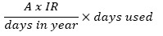
Status of Reforms: Safe harbour valuation methodologies
Current law – s 109CA
Use of assets = market value payment or deemed dividend since 1 July 2009.
No certainty around the valuation methods.
Board of Taxation (BOT) Report 2014
Retain current rules – deductibility and FBT exemption.
Safe harbour comparative transaction.
Distinguishes between depreciating and appreciating assets
Treasury Paper 2018
Safe harbour rules would consist of a formula:
A formal market valuation of the asset is required every five years
The rules apply to both appreciating and depreciating assets

Slide 7
Status of Reforms: Self Corrective Action
Current law – s 109RB,
PSLA 2011/29, and
TR 2010/4 Amnesty
FCT discretion for Honest Mistake or Inadvertent Omission
Informal self corrective action – audit risk
Board of Taxation (BOT) Report 2014
Self corrective action form ‘unintended breach’
Retain current FCT discretion loans and franking
Treasury Paper 2018
Self corrective action for ‘inadvertent breach’
Retain current FCT discretion franking only

Slide 8



Slide 9




